Slide 1
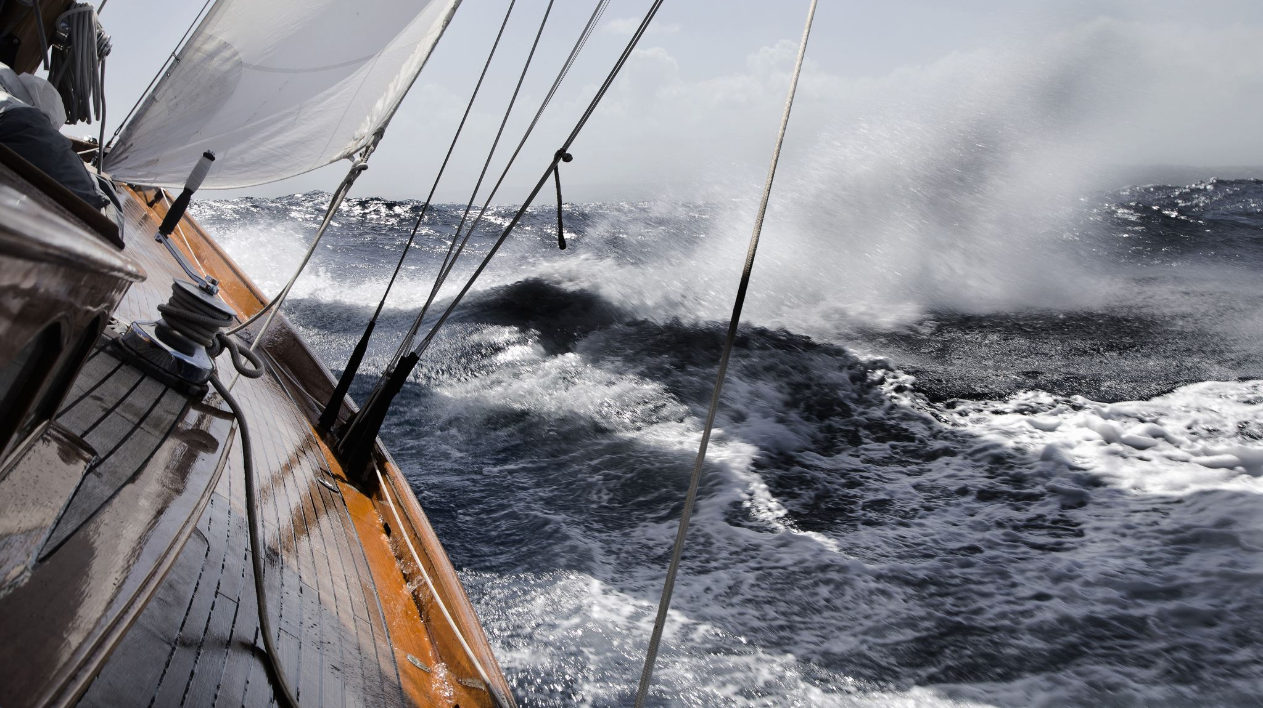
Belgian Sailing Awards 2022
Discover the candidates!

Slide 2
Ontdek hier de genomineerden Découvrez ici les nominées
Sailor of the Year Woman
Emma Plasschaert – ILCA 6
Eline Verstraelen – ILCA 6
Sophie Faguet – Keel Boats – Solo

Slide 3
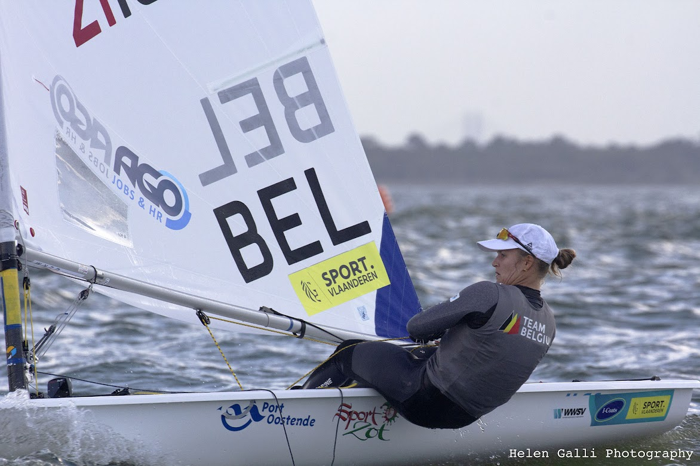
Ontdek hier de genomineerden Découvrez ici les nominées
Sailor of the Year Woman
Emma Plasschaert – ILCA 6
World Champion ILCA 6 Oman 2021
Bronze medal World Championships ILCA 6 2022
Fifth Place Europeans ILCA 6 Hyères France

Slide 4
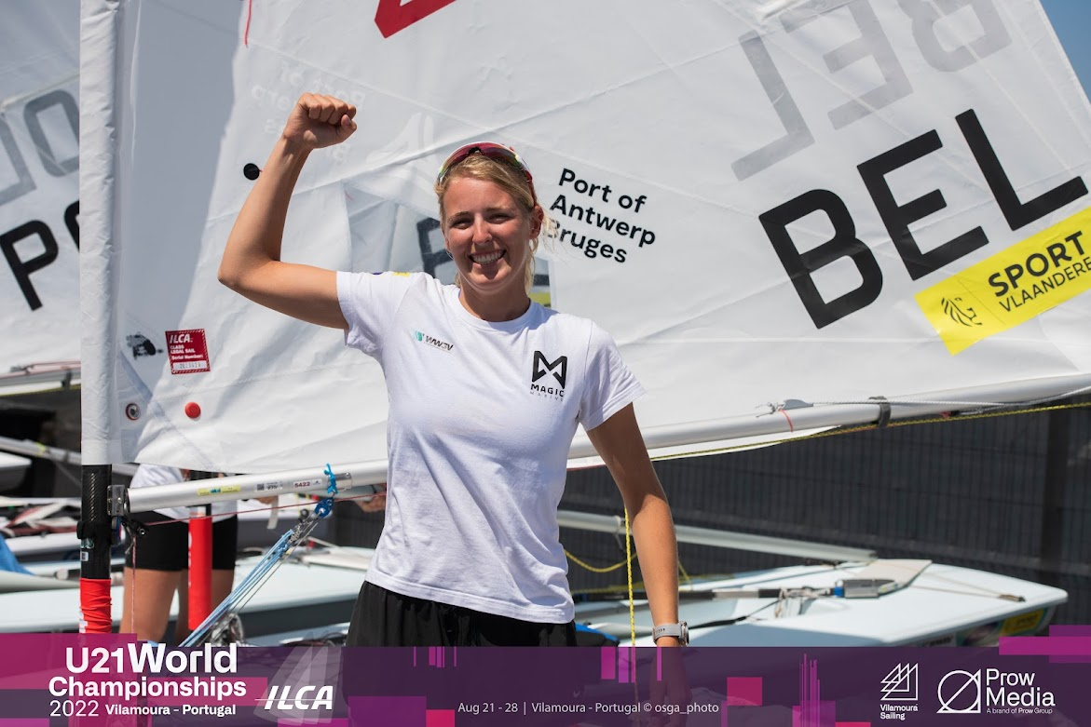
Ontdek hier de genomineerden Découvrez ici les nominées
Sailor of the Year Woman
Eline Verstraelen – ILCA 6
World Champion ILCA 6 U21 Oman 2022
36th place ILCA 6 Worlds 2022 (3th U21)
50th place ILCA 6 Europeans 2022

Slide 5
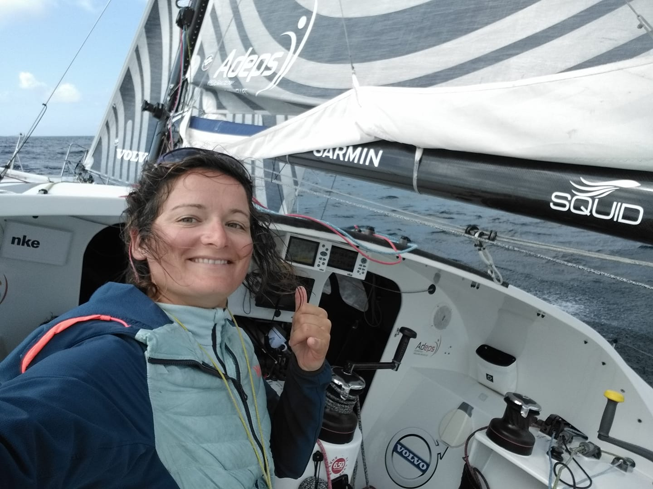
Ontdek hier de genomineerden Découvrez ici les nominées
Sailor of the Year Woman
Sophie Faguet Keelboat Solo
5 th place Mixed Double European Championships
4 th Dhream Cup Figaro 3

Slide 6
Ontdek hier de genomineerden Découvrez ici les nominés
Sailor of the Year Man
Jonas Gerckens – Keel Boats Solo
Patrick Demesmaker - Multihull
Gilles Buekenhout – Route du Rhum Multi
William De Smet – ILCA 7

Slide 7
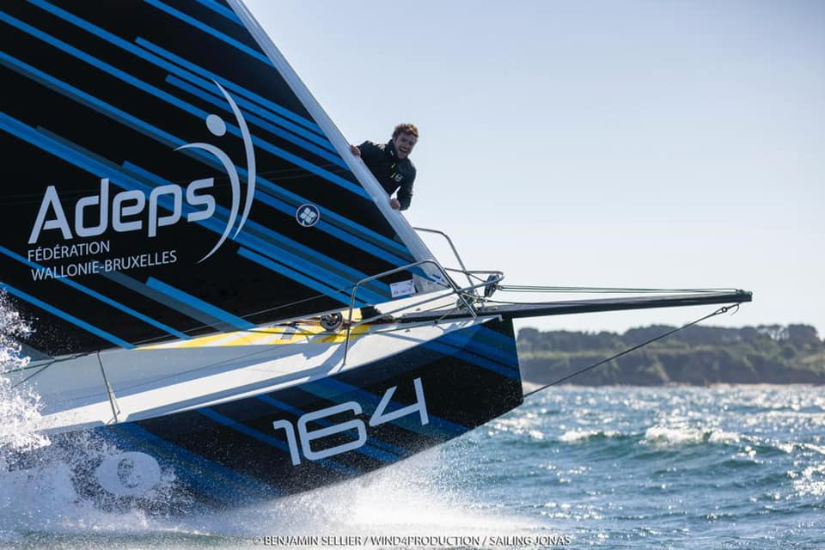
Ontdek hier de genomineerden Découvrez ici les nominés
Sailor of the Year Man
Jonas Gerckens – Keel Boat Solo
5th place Double Mixed European Championships 2022 Figaro 3
Route du Rhum Class 40 Volvo - abandoned
21 th place Dhream Cup – Class 40

Slide 8
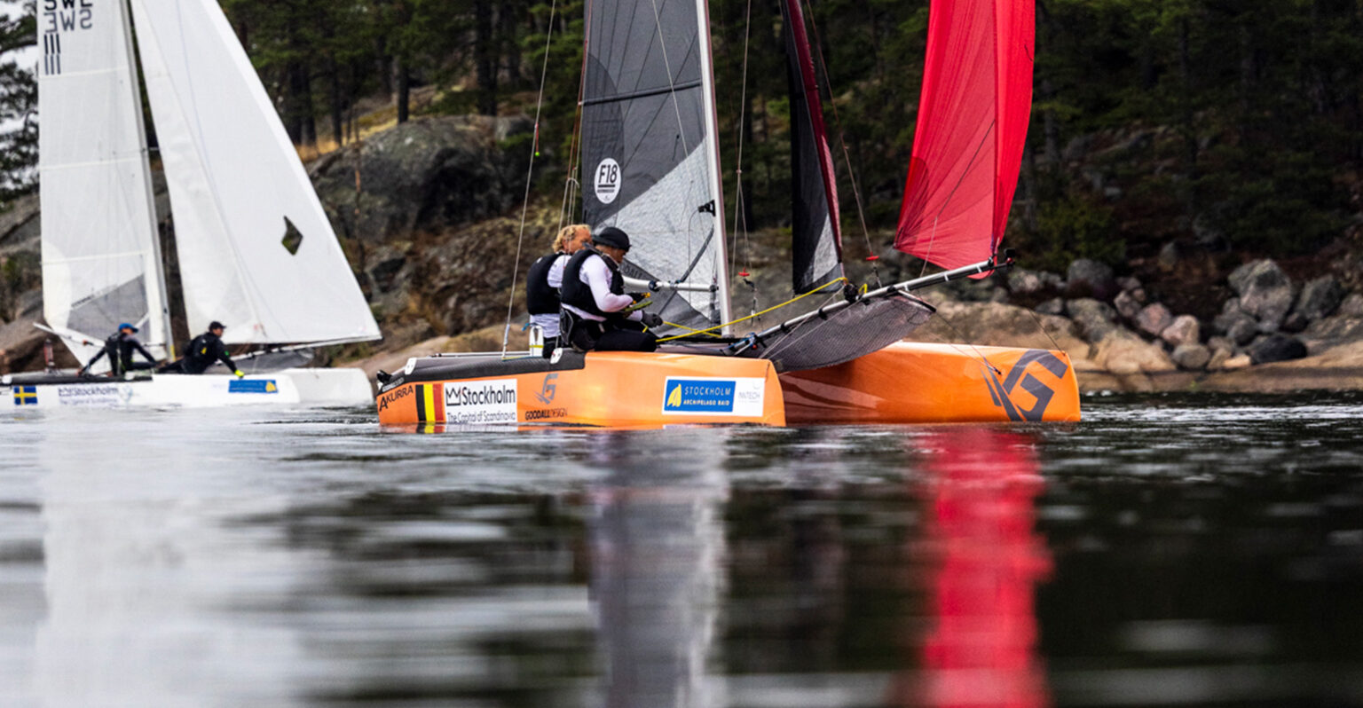
Ontdek hier de genomineerden Découvrez ici les nominés
Sailor of the Year Man
Patrick Demesmaeker – Multihull F18
World Champion Multihull Raid 2022
3th European Championships F18 2022
3th St.-Barth Cata Cup F18 2022

Slide 9
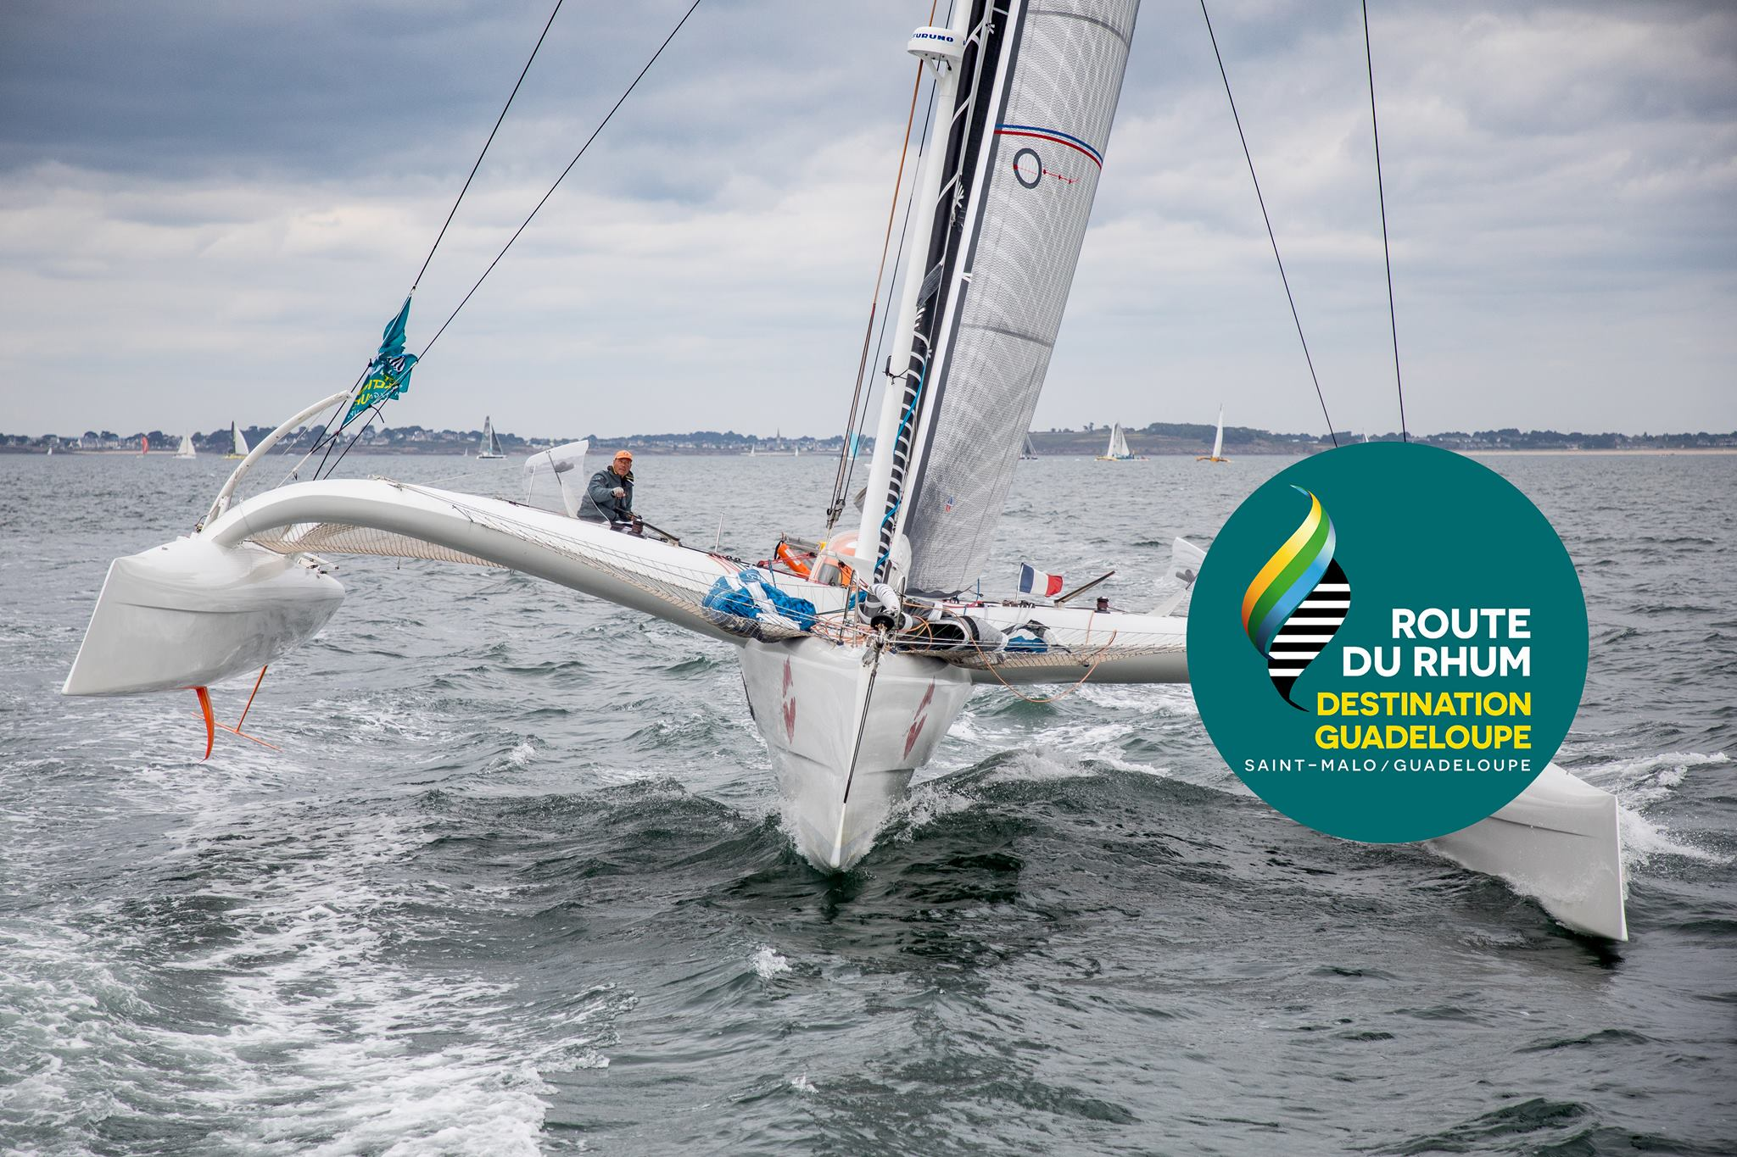
Ontdek hier de genomineerden Découvrez ici les nominés
Sailor of the Year Man
Gilles Buekenhout – Route du Rhum
Third participation Route du Rhum
Capsizing while in the lead at 200 miles of Guadeloupe

Slide 10
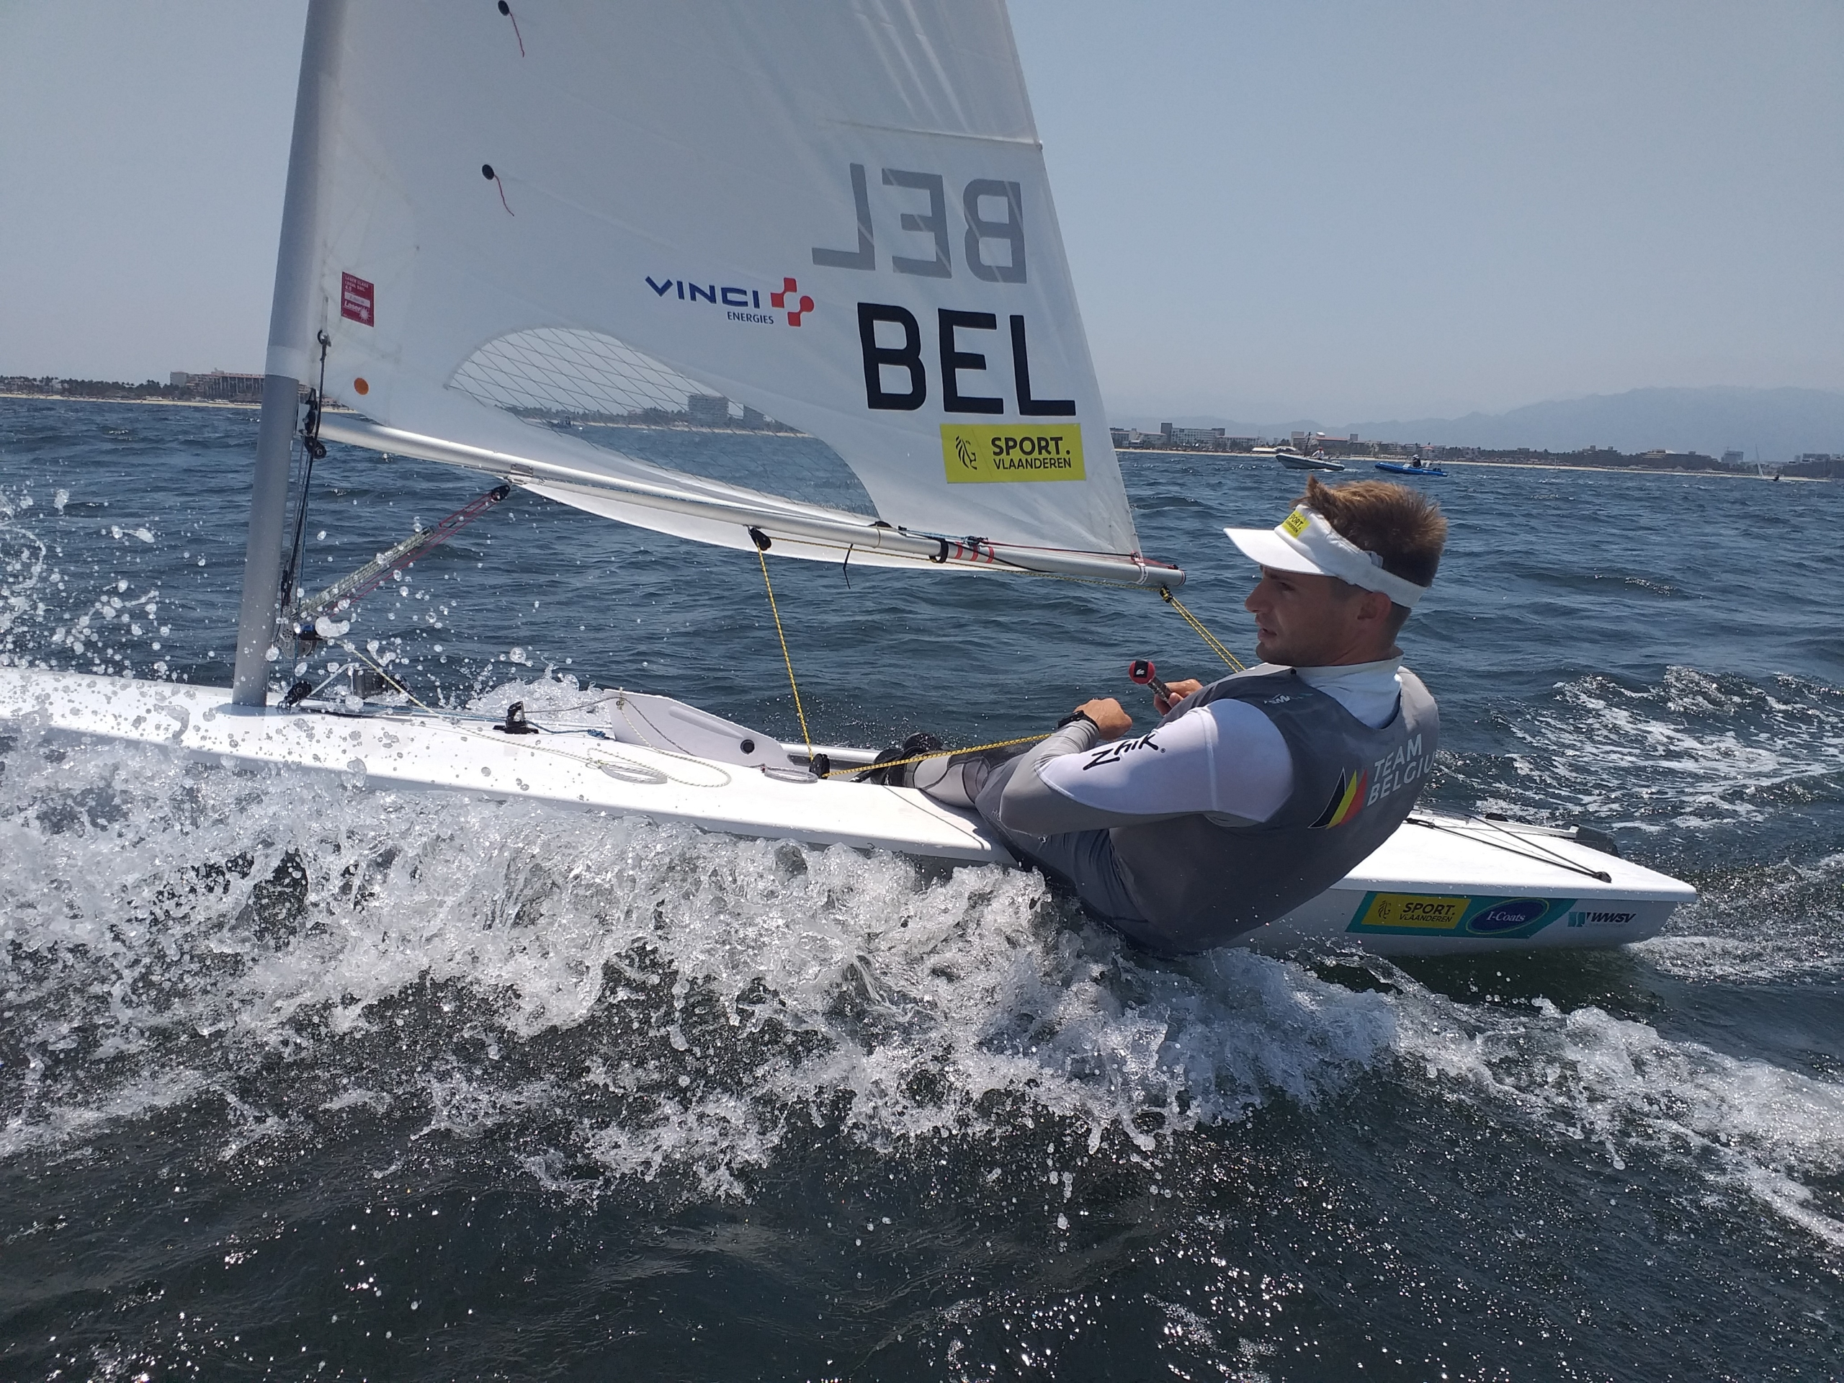
Ontdek hier de genomineerden Découvrez ici les nominés
Sailor of the Year Man
William De Smet – ILCA 7
Second place ranking World Sailing 2022
15th European Championships 2022 Hyères France
24th World Championships Mexico
5th Kieler Woche 2022

Slide 11
Ontdek hier de genomineerden Découvrez ici les nominés
Sailor of the Year Team
Team Moana – Keelboats IRC
Sea Jou 2 – J80 class
Loïc Schoonooghe – Emiel Van Daele - Cadet
Isaura Maenhaut – Anouk Geurts – 49FX

Slide 12
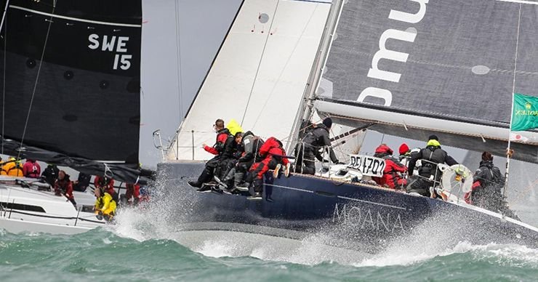
Ontdek hier de genomineerden Découvrez ici les nominés
Sailor of the Year Team
Team Moana – Keelboat IRC
Winner Cowes Week 2022
Overall Winner European Championships IRC 2022 Breskens Holland

Slide 13
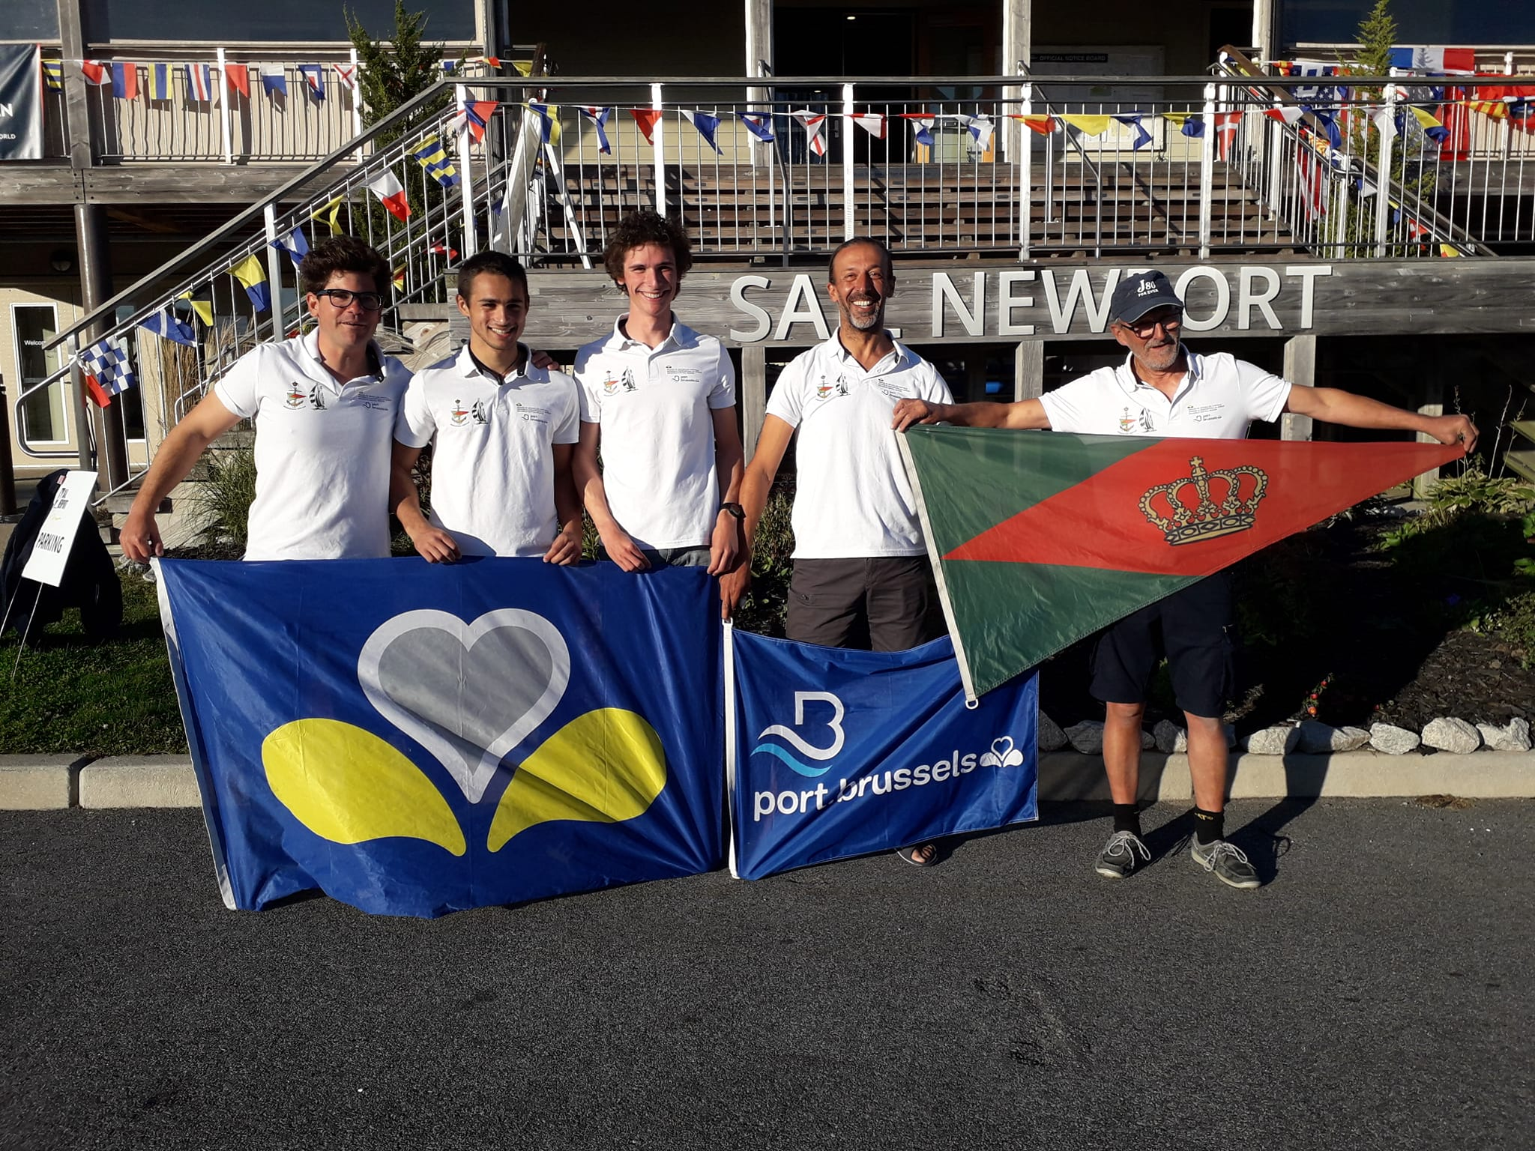
Ontdek hier de genomineerden Découvrez ici les nominés
Sailor of the Year Team
Sea Jou 2 – J80
3th place World Championships J80 Amateur
2th place ONK J80
Belgian Champion J80
Silver Flanders Trophy 2022

Slide 14
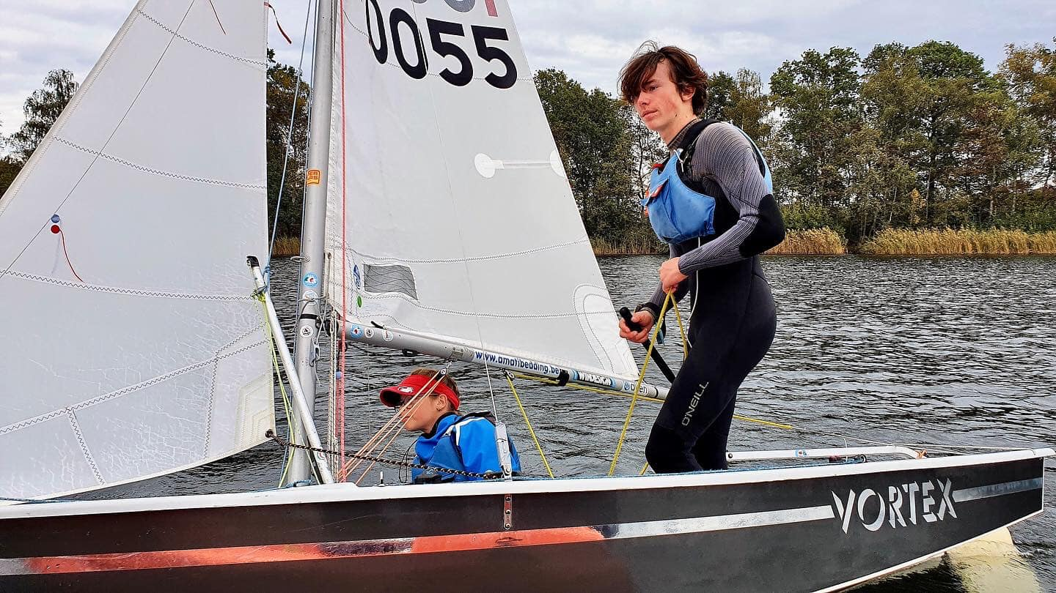
Ontdek hier de genomineerden Découvrez ici les nominés
Sailor of the Year Team
Loïc Schoonooghe – Emiel Van Daele – Cadet Class
Belgian Champion Cadet 2022 – Nieuwpoort
Dutch Champion Cadet 2022 – Dutch Youth Regatta
2th European Championships 2022 Torbay (UK)

Slide 15
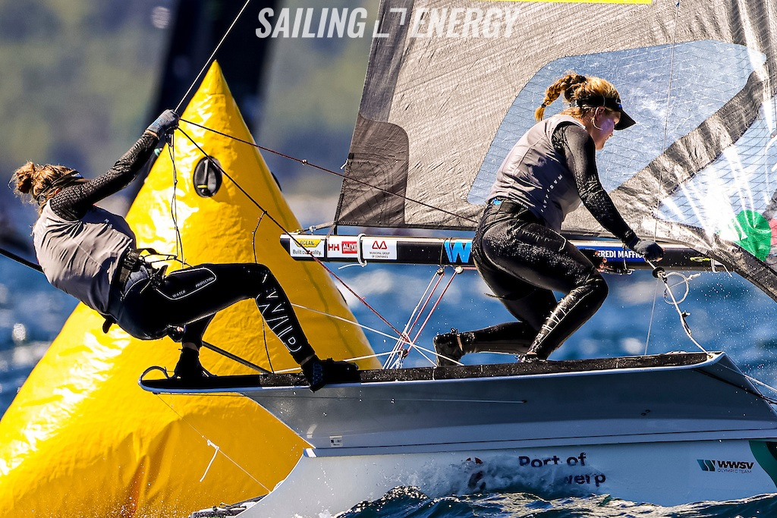
Ontdek hier de genomineerden Découvrez ici les nominés
Sailor of the Year Team
Isaura Maenhaut – Anouk Geurts – 49FX
Second on World Ranking World Sailing 2022
10th World Championships 2022 Nova Scottia
26th European Championships 2022
5th Kieler Woche 2022
2th Allianz Regatta 2022

Slide 16
Ontdek hier de genomineerden Découvrez ici les nominés
Sailor of the Year Talent
Emiel De Clercq – Bic Techno 293 Plus
Sol Degrieck – PWA Windsurfing Wave
Daan Baute – Formula Kite
Alice Da Col – Europe Class

Slide 17
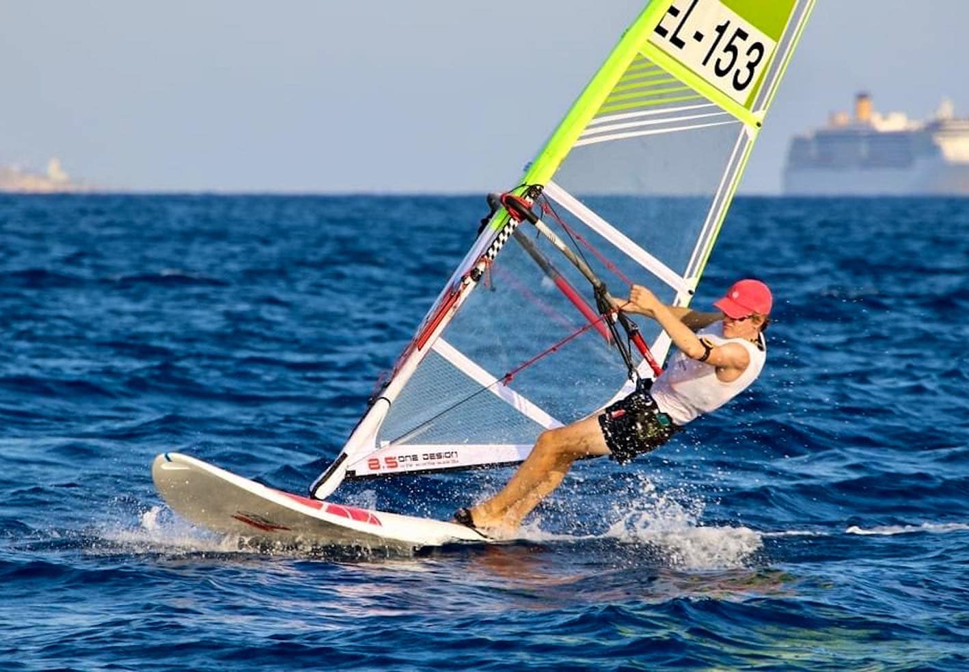
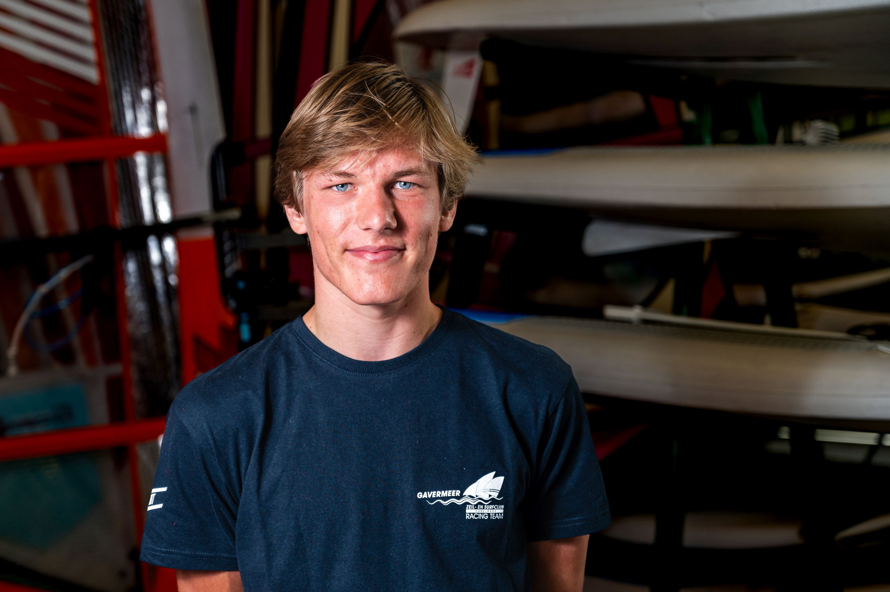
Ontdek hier de genomineerden Découvrez ici les nominés
Sailor of the Year Talent
Emiel De Clerck – Bic Techno Plus
Vice-World Champion Bic Techno 293 Plus Cyprus
4th Techno Europeans 2022 U19 Cagliari
Overall Winner North Sea Cup 2022
Belgian Champion Bic Techno 293 2022 Overall

Slide 18
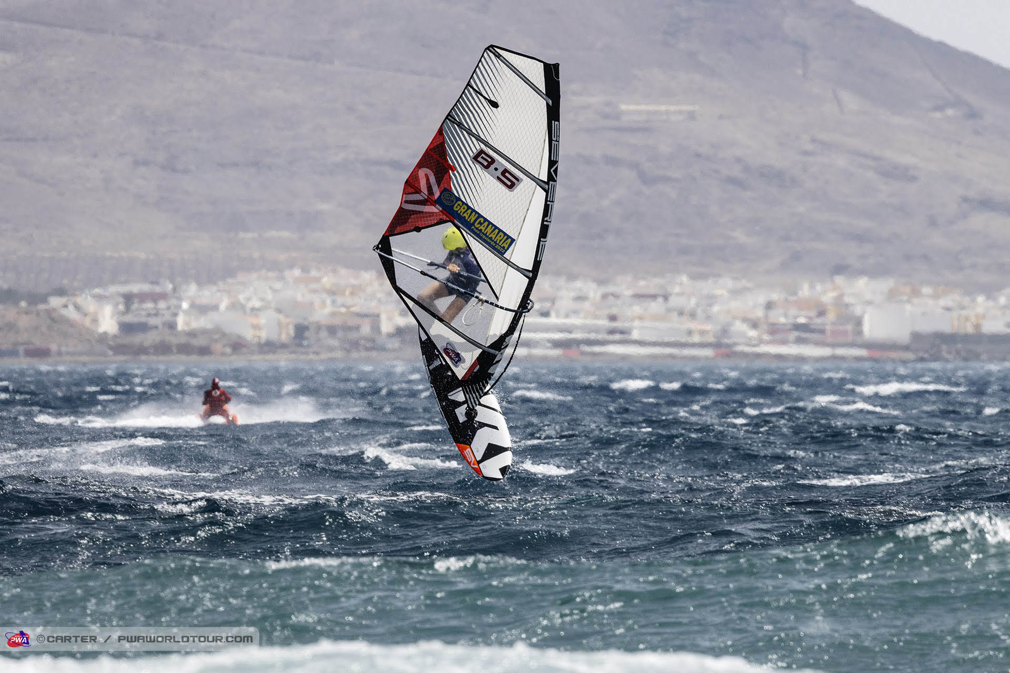
Ontdek hier de genomineerden Découvrez ici les nominées
Sailor of the Year Talent
Sol Degrieck – PWA Windsurf Wave
PWA Denemarken – 2th U17 – 3th U20
Vice World Champion 2022 Wave U17
9th overall PWA Pozo Gran Canaria 2022
Only 12 years old
12th World Cup Sylt 2022
3th Expression Session Sylt 2022
8th position World Ranking Pro Wave

Slide 19
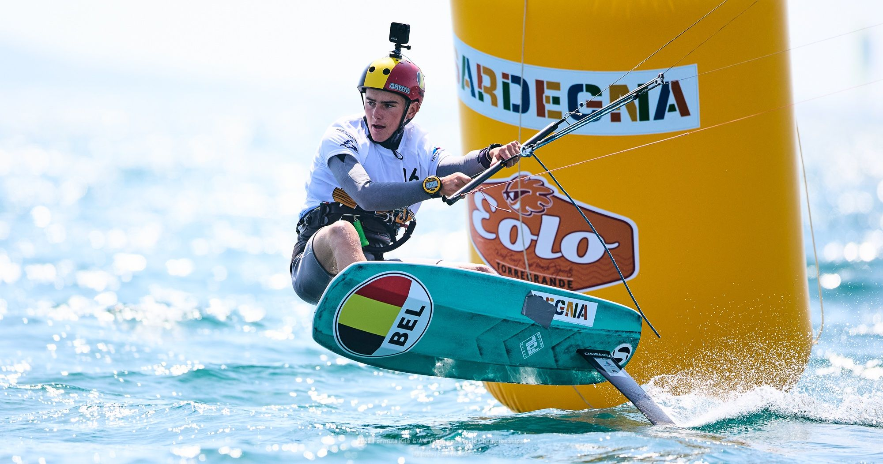
Ontdek hier de genomineerden Découvrez ici les nominés
Sailor of the Year Talent
Daan Baute – Formula Kite
WK Formula Kite 12th Bronze Group 2022
9th Youth World Championships 2022 Scheveningen

Slide 20
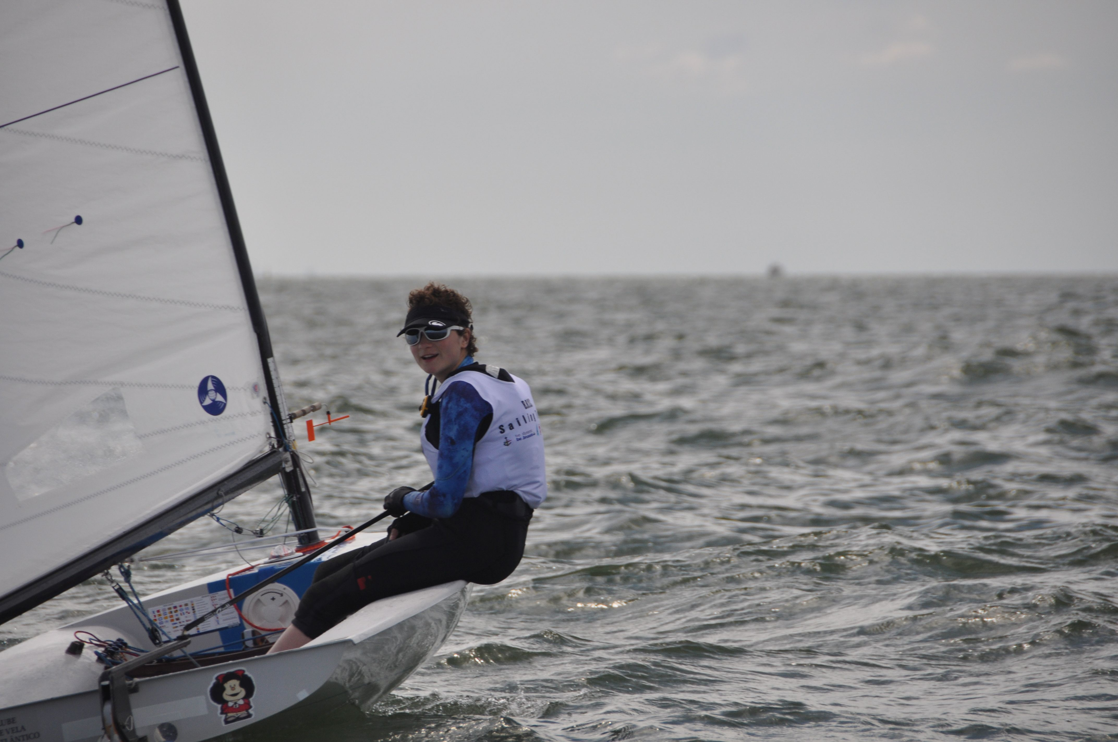
Ontdek hier de genomineerden Découvrez ici les nominés
Sailor of the Year Talent
Alice Da Col – Europe Class Woman
Winner Europe Trophy Belgium 2022
Great comeback after a very difficult start of the season – respect!
Second place Nieuwpoortweek 2022

Slide 21
Ontdek hier de genomineerden Découvrez ici les nominés
Sailor of the Year Manager
Race and Rescue Team RYCB – Race Management
Mady Fobert – BRYC Sailing School, J80, Touvoile, Belgian Sailing
Tommy Maenhaut – Surfdisciplines Belgium
Sailing for Think Pink – Sigrid Huyghe – Woman in Sports
Robert “Bob” Leclercq – International Race Mangement

Slide 22
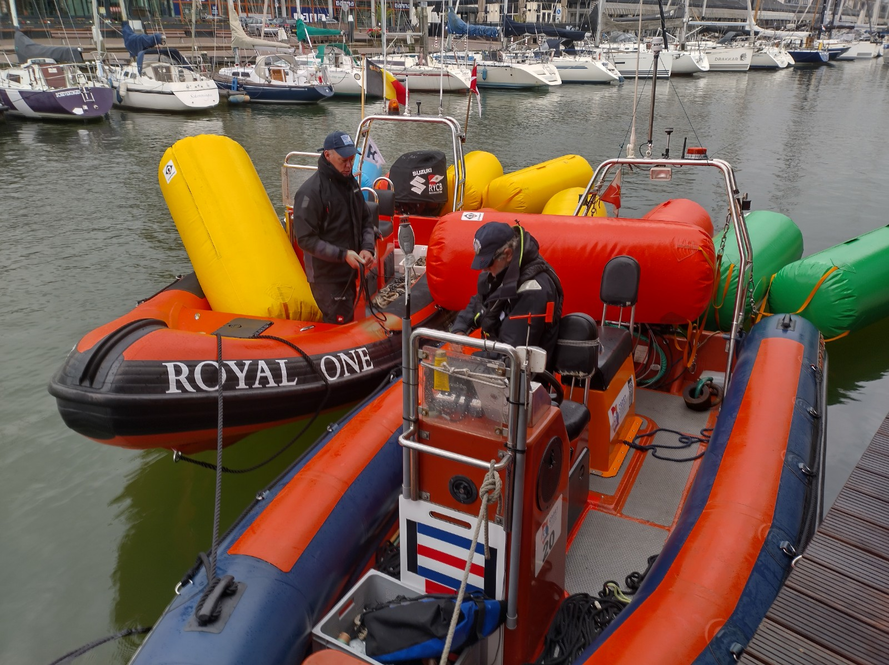
Ontdek hier de genomineerden Découvrez ici les nominés
Sailor of the Year Manager
Race and Rescue Team RYCB – National and International Race Management
Great team of more than 50 expert volunteers
Excellent equipment for Race Management with specially equiped boats
International and international engagements with World Cup in Scheveningen 2023 already booked

Slide 23
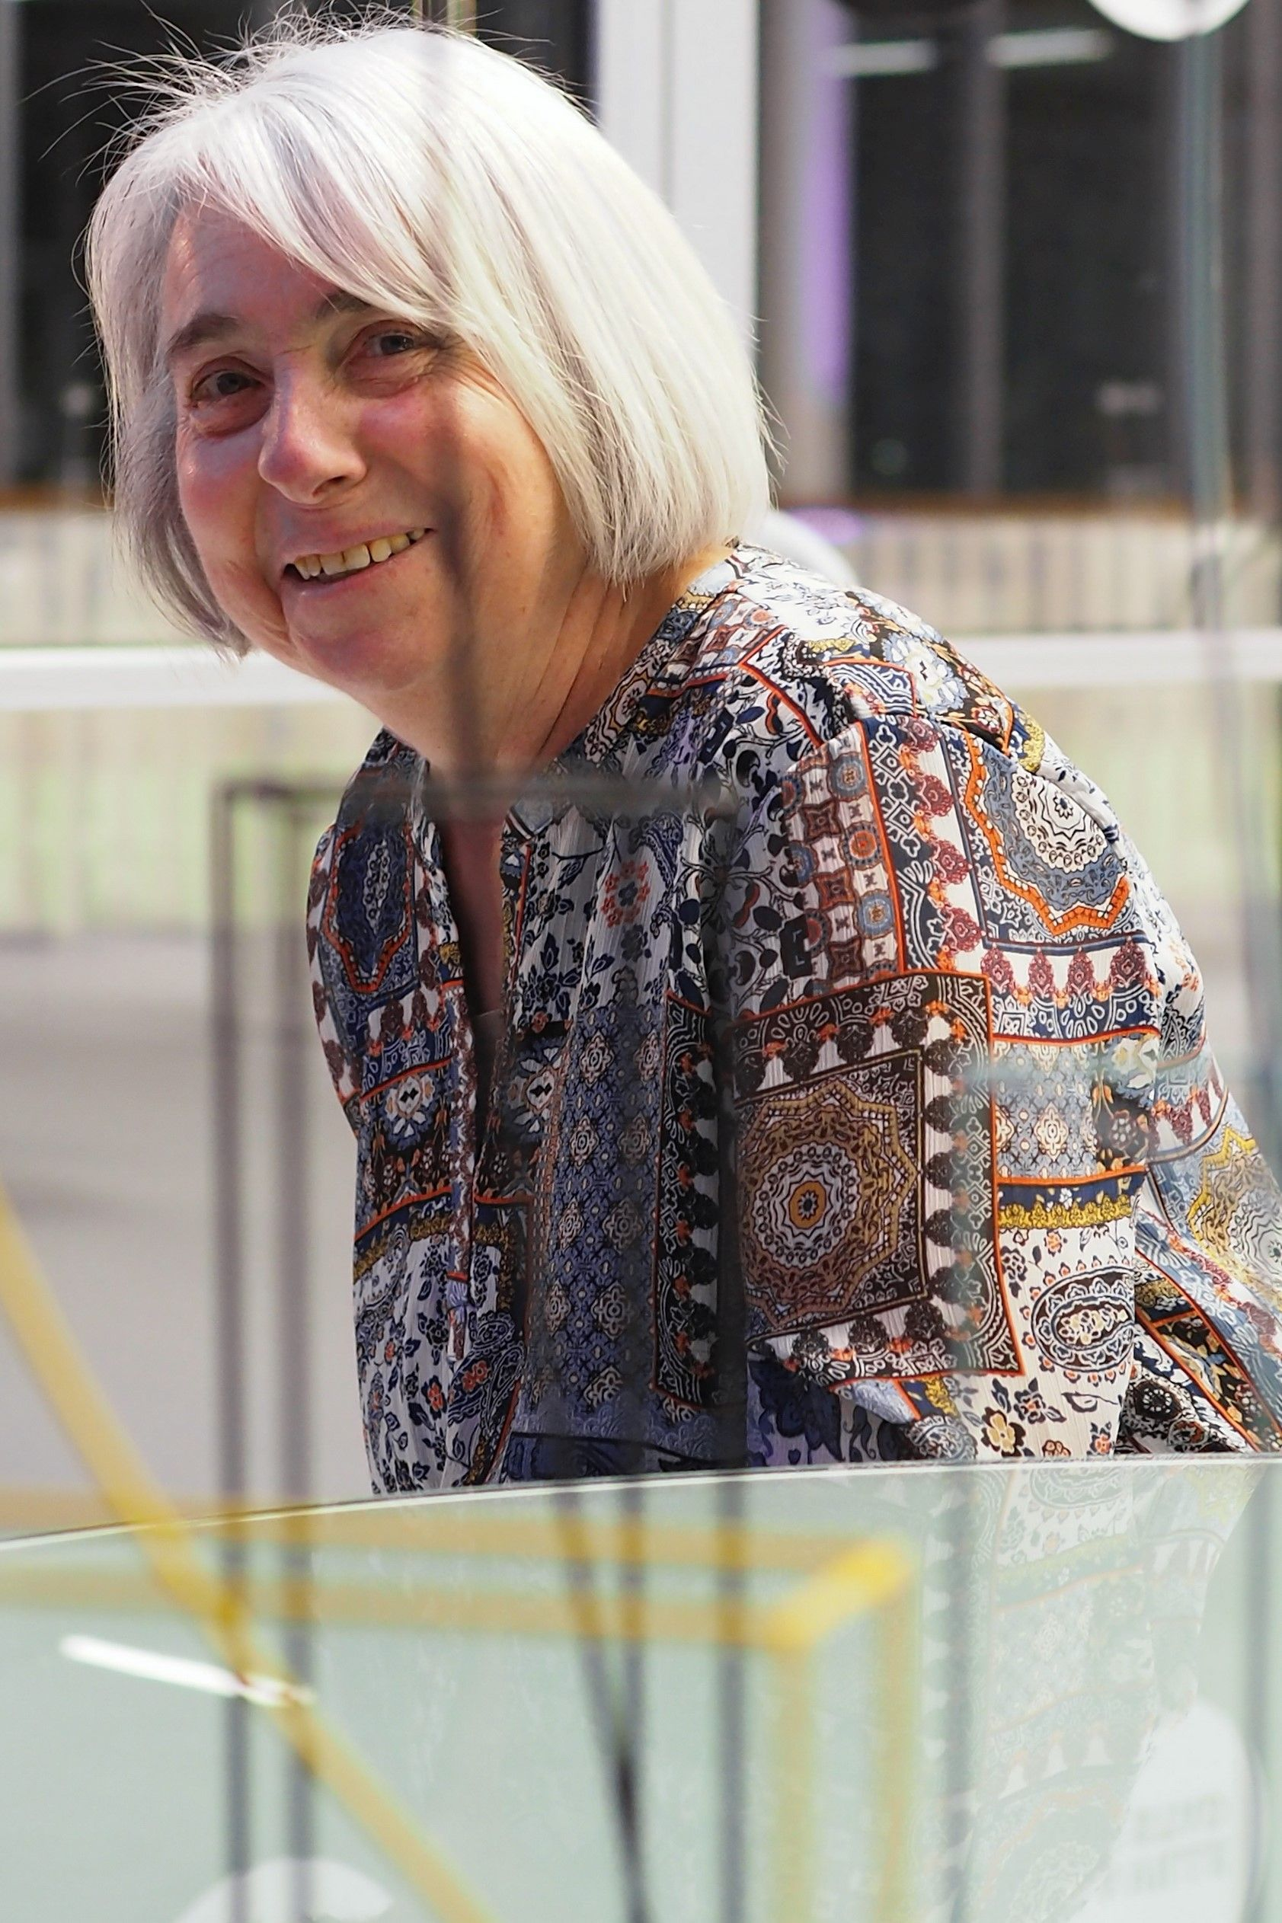
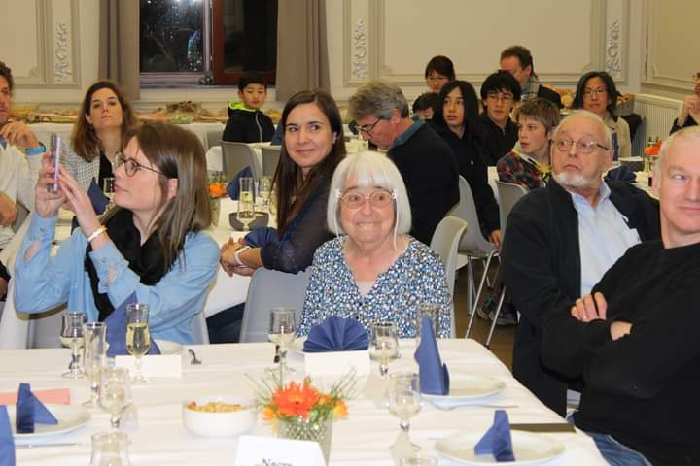
Ontdek hier de genomineerden Découvrez ici les nominés
Sailor of the Year Manager
Mady Fobert – Sailing School and Team Management
The engine after the succesfull BRYC Sailing Academy
Management BRYC Teams on Worlds J80
Responsable for competition@BRYC
Engine of 30 years Tourvoile – Tour de France à la Voile

Slide 24
Ontdek hier de genomineerden Découvrez ici les nominés
Sailor of the Year Manager
Tommy Maenhaut –Surfing Development programs
More than 15 years at the helm of developping surfdisciplines in Belgium
Management Regatta’s in several disciplines : from windsurfing to kitesurfing to waveriding, sup and Wing Foil

Slide 25
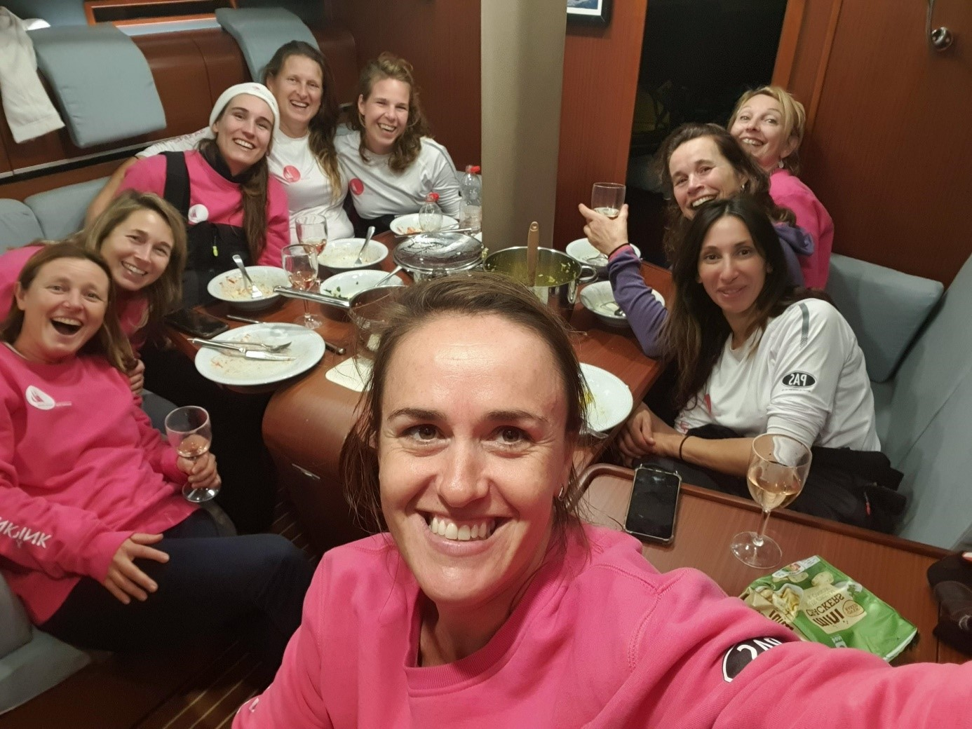
Ontdek hier de genomineerden Découvrez ici les nominés
Sailor of the Year Manager
Sailing for Think Pink Sigrid Huyghe
Project to introduce more woman in Sailing
Raising awareness for Think Pink
Activating Sailing in recreational sailing

Slide 26
Ontdek hier de genomineerden Découvrez ici les nominés
Surfer of the Year
Thomas Broucke – IQFoil
Cyril Evrard – PWA Slalom IQFoil
Daan Baute – Formula Kite
Vincent Valkenaers – Speed Windsurfen

Slide 27
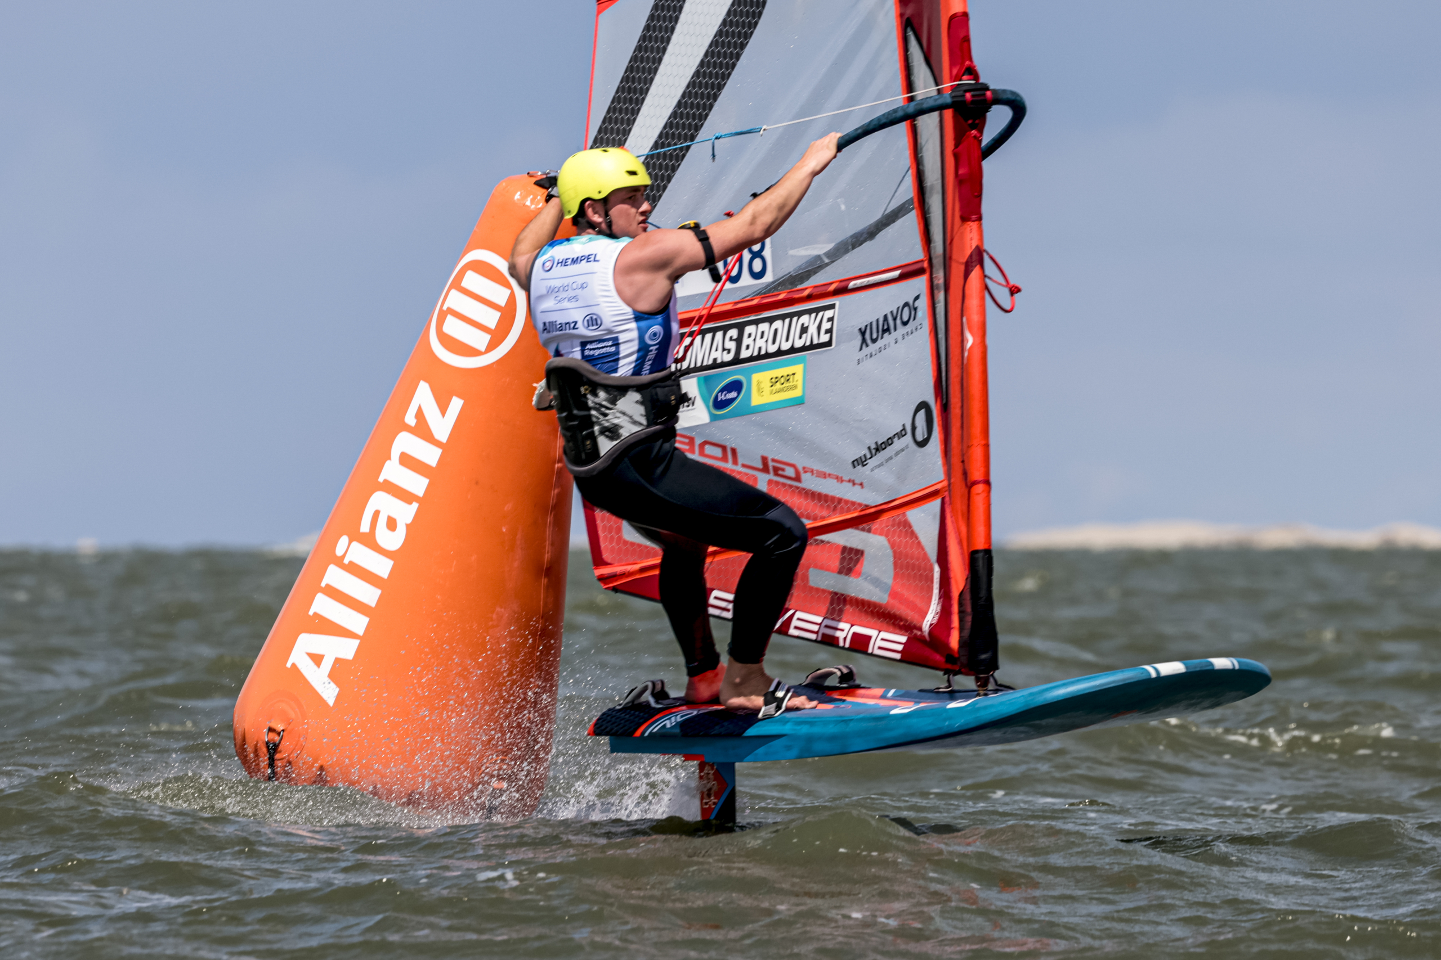
Ontdek hier de genomineerden Découvrez ici les nominés
Surfer of the Year
Thomas Broucke iQFoil
Olympic preparation for OS 2024 Paris/Marseille
39th Worlds iQFoil 2022 Brest
61th Worlds iQFoil U21 Torbole

Slide 28
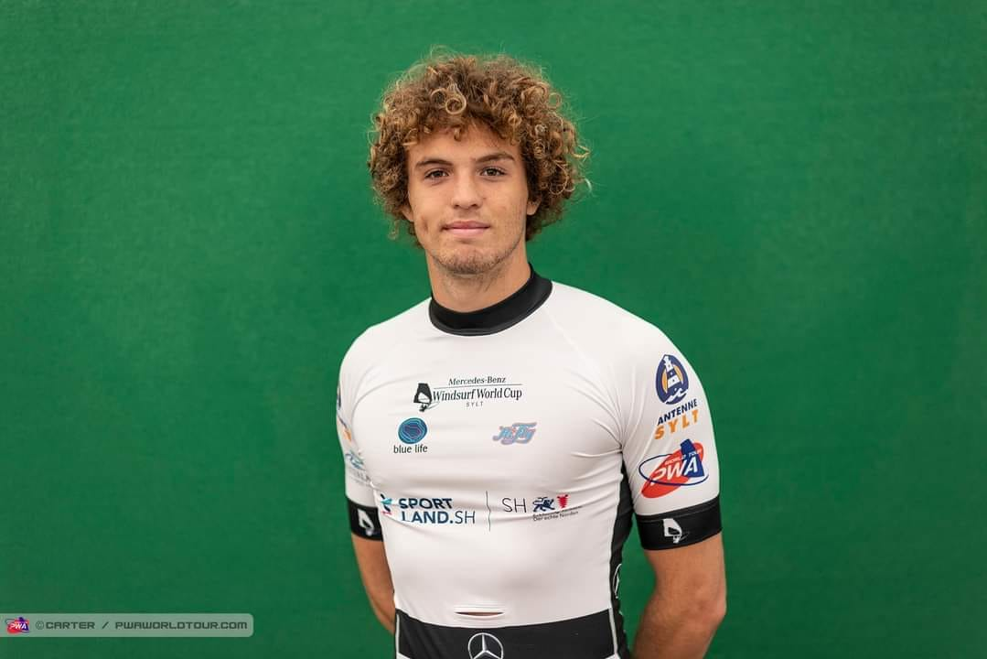
Ontdek hier de genomineerden Découvrez ici les nominés
Surfer of the Year
Cyril Evrard – PWA Slalom Windsurfing
3th Youth European Slalom U21
Winner Speedweek Fuerteventura U21 – 6th overall
6th IFCA Youth Words U21
Vice-champion Dutch Slalom Championships
PWA Slalom Japan 28th

Slide 29
Ontdek hier de genomineerden Découvrez ici les nominés
Sailor of the Year Talent
Daan Baute – Formula Kite
WK Formula Kite 12th Bronze Group 2022
9th Youth World Championships 2022 Scheveningen

Slide 30
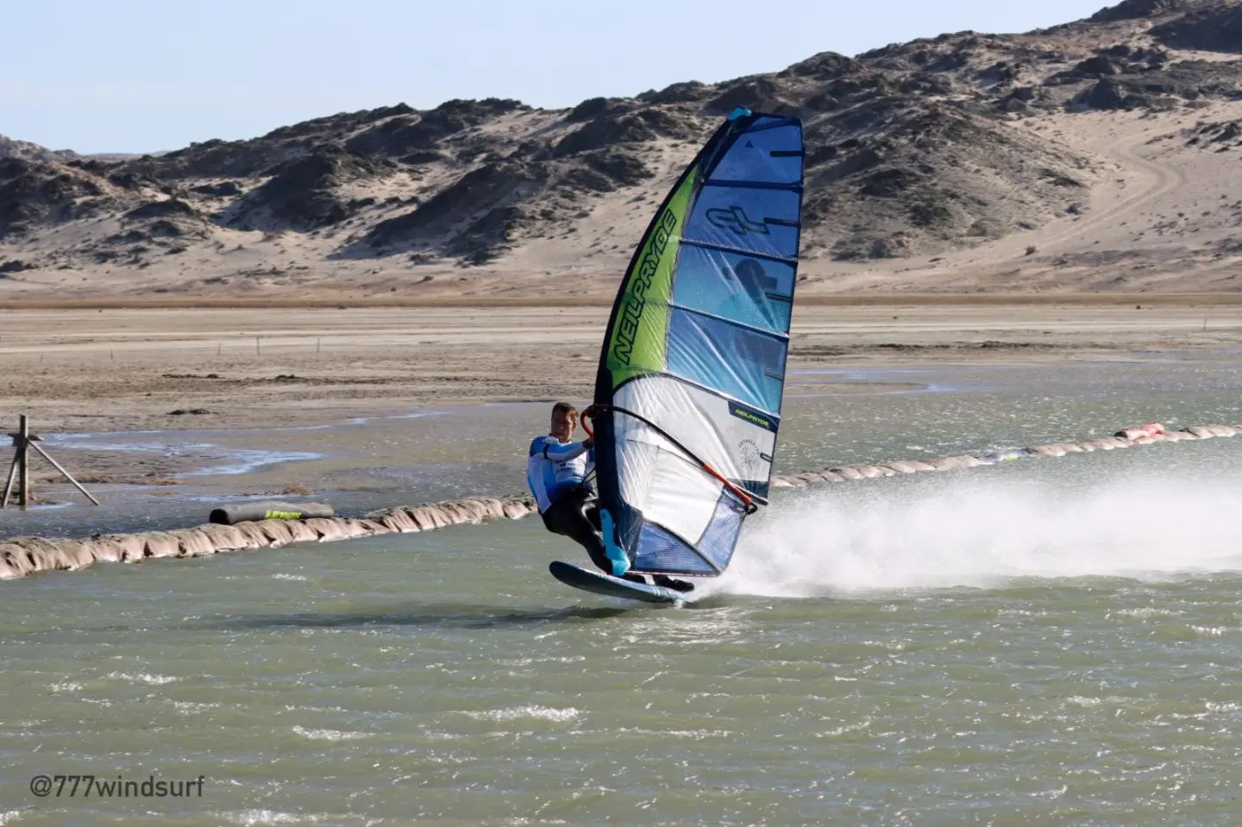
Ontdek hier de genomineerden Découvrez ici les nominés
Surfer of the Year
Vincent Valkenaers Speed Windsurfing
Fastest man on the water in 2022
Winner Luderitz Speed Challenge by more than 2 knots
Approaching own national record with 53,08 knots of 98,30 km/h over 500 m
World Record in view for 2023 – topsnelheid almost 100 km/h

